Slide 1
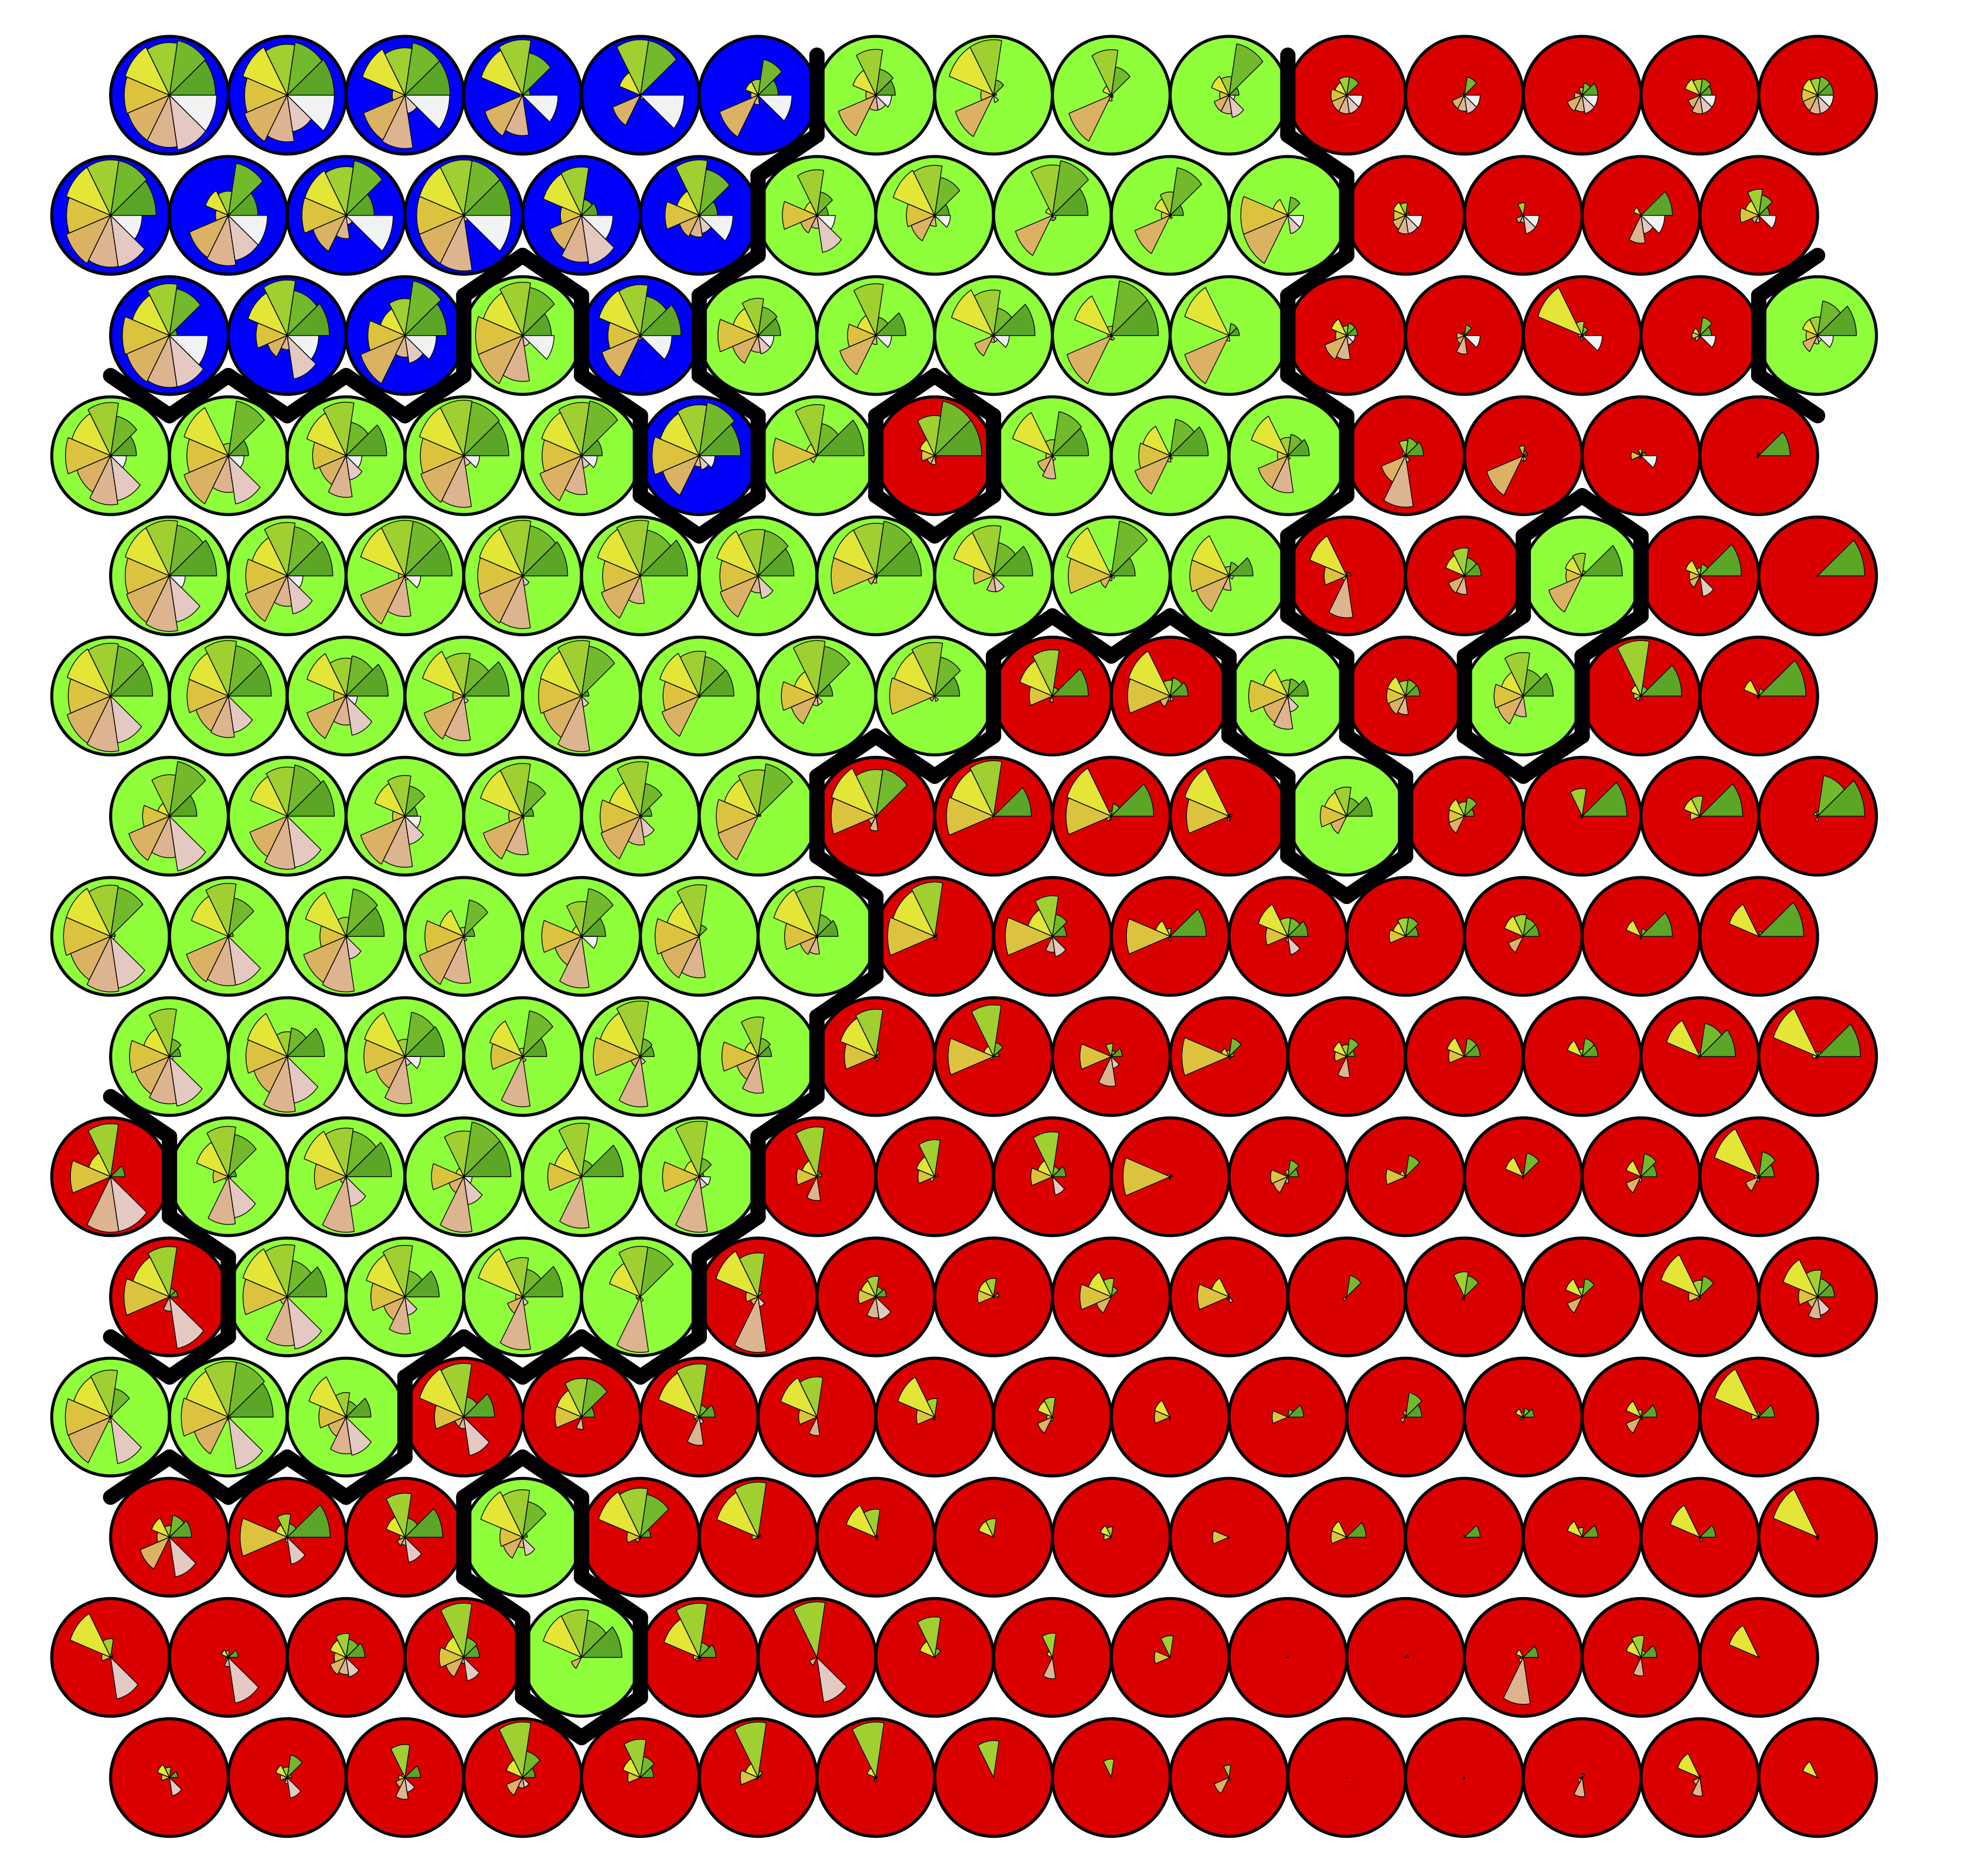
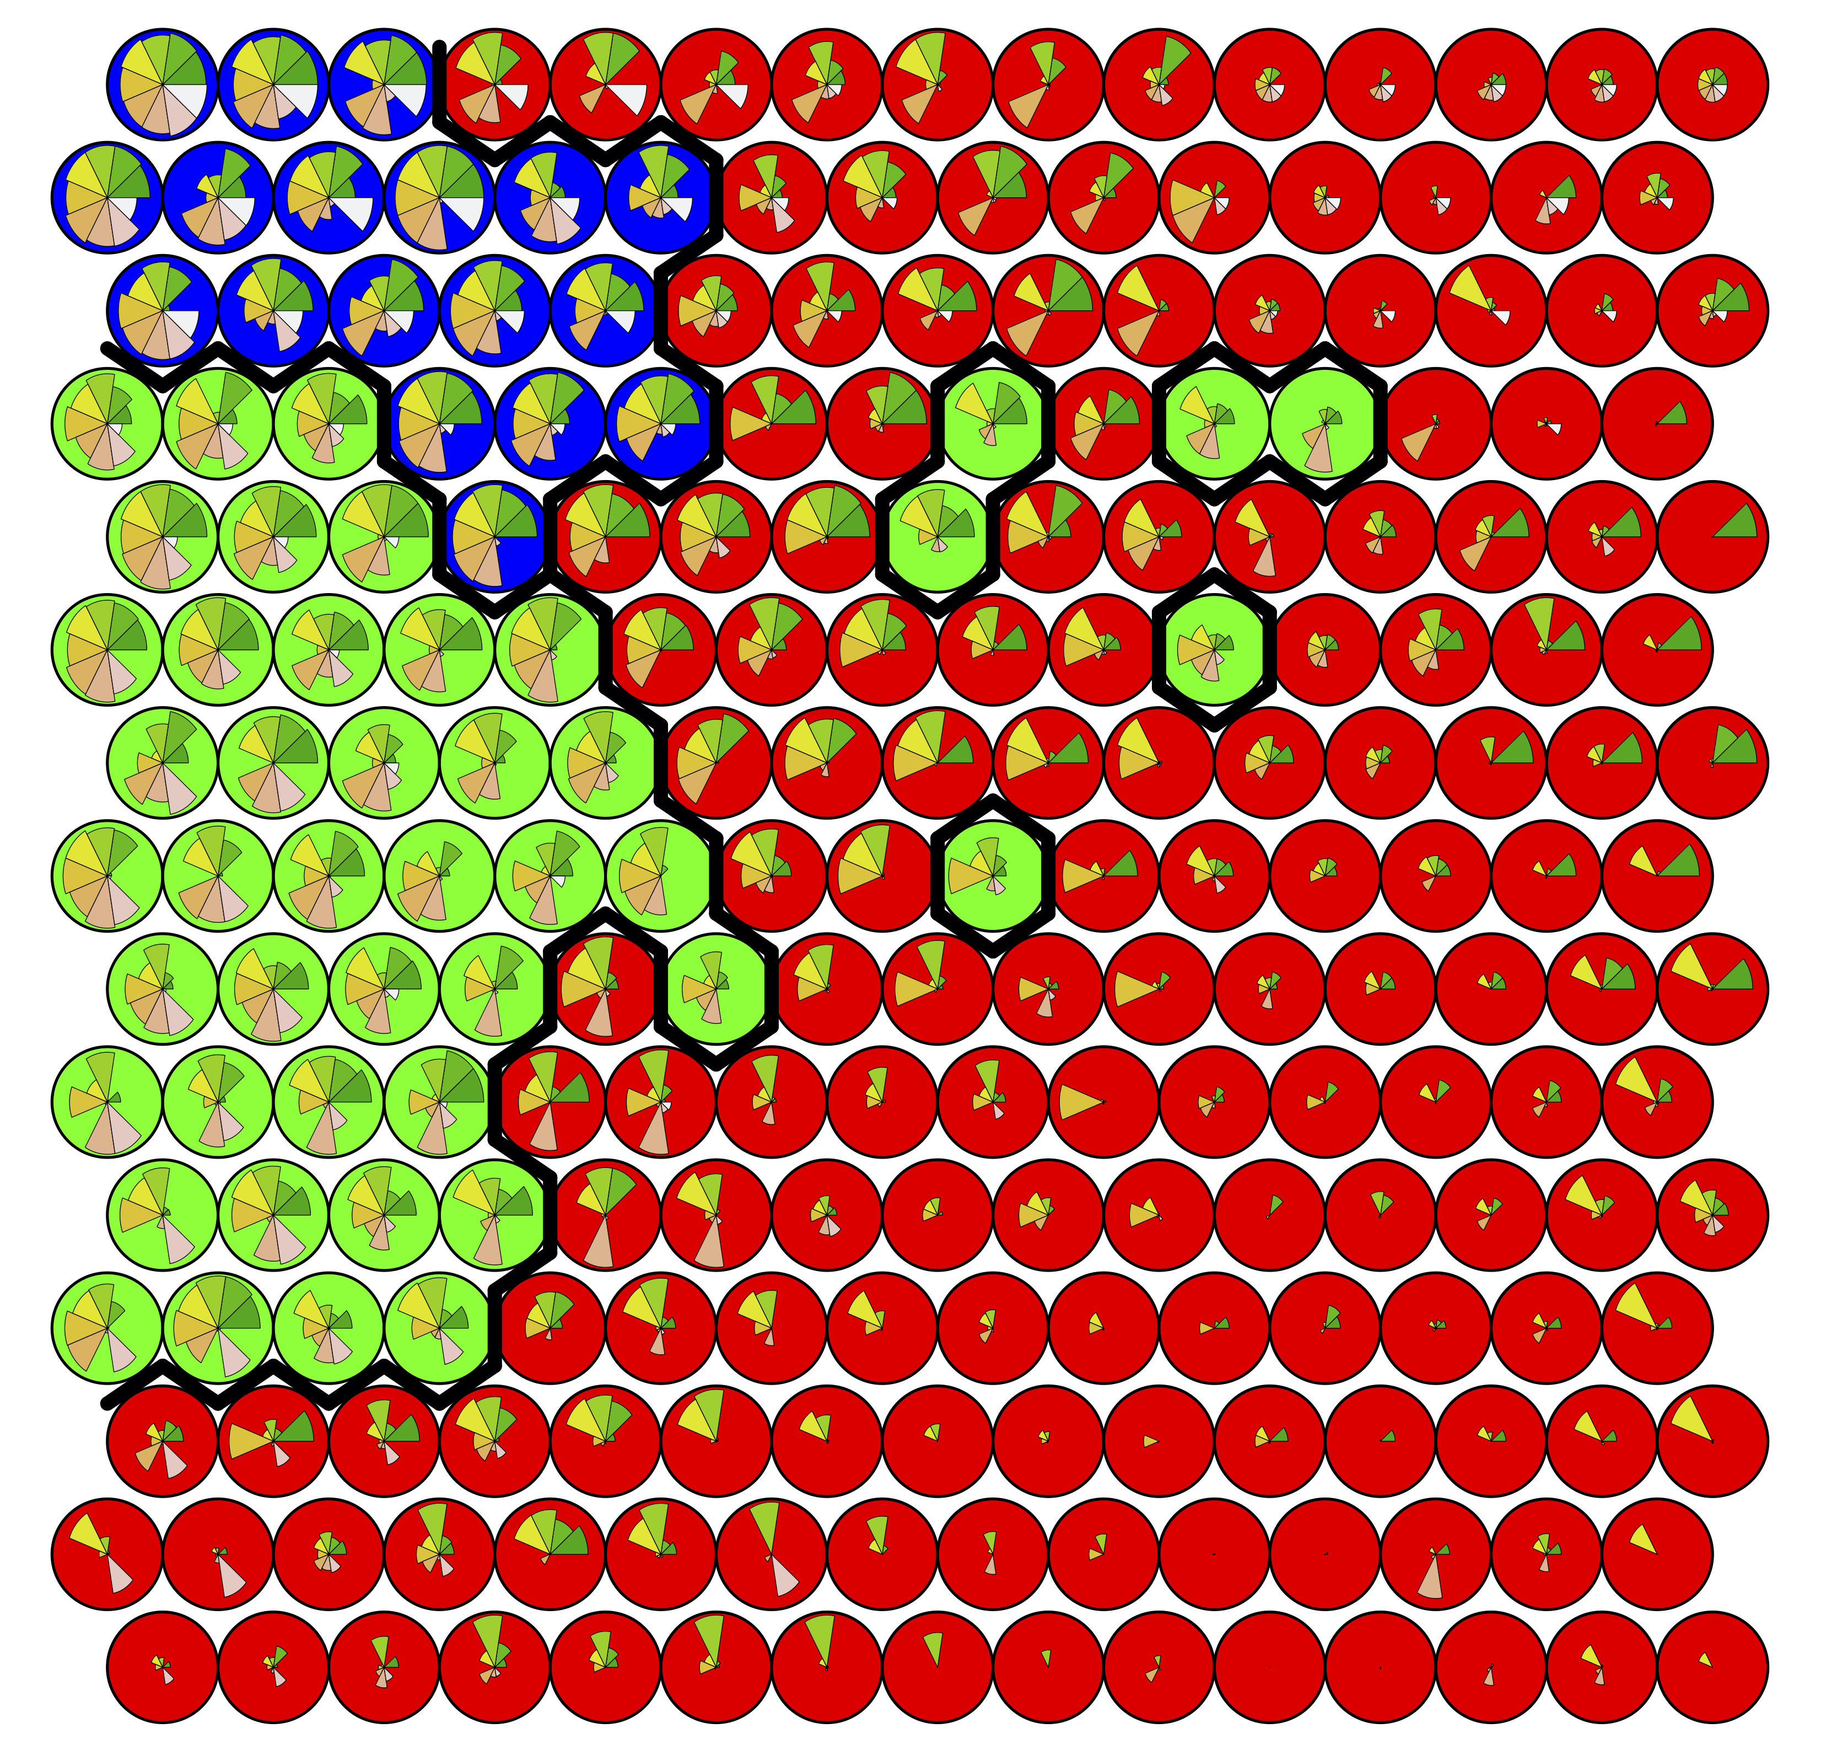
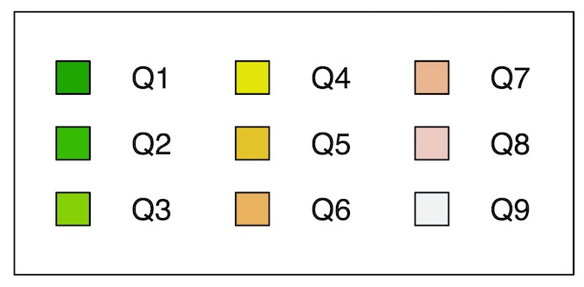
Figure XXa: Self Organizing Map
15x15 lattice, hexagonal topology
Euclidean Metric
Figure XXb: Self Organizing Map
15x15 lattice, hexagonal topology
Manhattan Metric
C1
C2
C3

